Slide 1
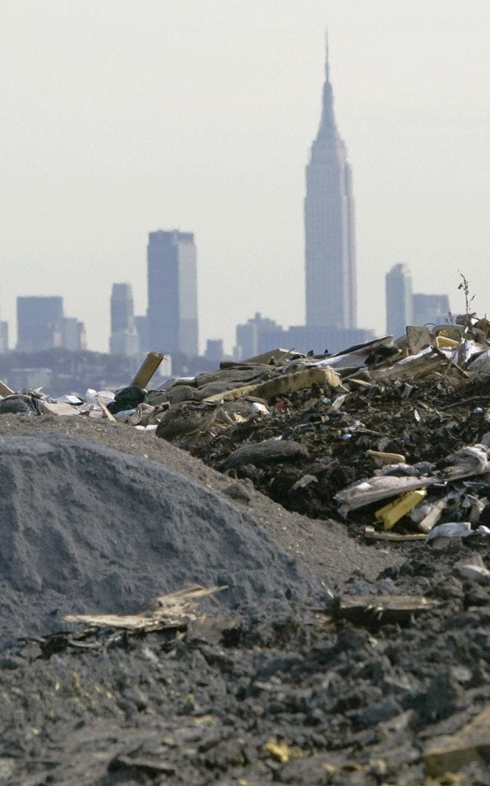
LocateYourWaste:
Website to Lessen Pollution & Increase Personal Impact
Team H
Dariga, Himanshi, & Yuki

Slide 2
Table of Contents
01
02
Project Abstract & Motivation
Website Features

Slide 3

Project Abstract & Motivation
01

Slide 4
Think:
Do you know how much waste NYC is collecting and recycling everyday?
More importantly, are you aware of how dire the current waste production & management problem in NYC is?

Slide 5
Did You Know…
14 Million Tons
$452 Million
7.8 Million Miles
of waste are produced annually in NYC
spent on shipping out 3.4 million tons of household trash
are driven by Diesel trucks annually carrying solely Manhattan’s waste

Slide 6
Currently…
Compared to Other Major Cities…
$1.83 Billion
even with a
NYC holds a diversion rate of 17.6% in 2021, around 40-60% lower than those of Seattle, LA, & SF
NYC produces 14 million tons of annual waste, around 9-12 million tons more than Chicago, Boston, & Philadelphia
budget on NYC’s sanitation,
NYC is nowhere close to:
meeting its 2015 goal of sending zero waste to landfills by 2030
meeting its goal of a 33% diversion rate

Slide 7
How Can We Fix This?
Allow Personal Impact
Increase Transparency
Give NYC residents better, easier, & greater access to information on the city’s current waste production levels & recycling trends
Allow NYC residents to find methods they can personally contribute to alleviating the NYC waste overflow problem
we present LocateYourWaste!

Slide 8
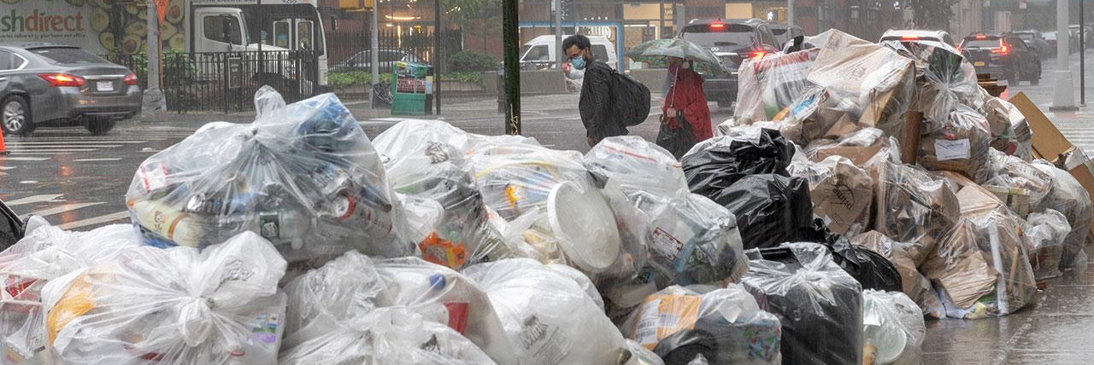

Website Features
02

Slide 9
LocateYourWaste Provides…
Produce up-to-date visualizations & analysis of NYC’s waste, recycling, & cleanliness as a whole
Allow users to find specialized waste drop-off locations near them
1
2
3
4
Provide a one-stop shop to all relevant NYC waste, recycling, & cleanliness information
Produce up-to-date visualizations & analysis of each borough’s waste, recycling, & cleanliness

Slide 10
Featured Pages
Waste by Borough
interactive → choose which borough you’d like to look at specifically
infographics of:
Borough demographics
Annual total waste production
Annual total waste production by waste type
Yearly recycling trends
Street cleanliness ratings
Waste Drop-Off Locations
Waste in NYC
infographics of:
2022 in tons
Annual total waste production
Annual total waste production by waste type (refuse, paper, MGP)
Annual total waste production by borough
Ranking of boroughs by waste production
interactive → choose what type of specialized waste you’d like to drop-off & which borough/address you are located at
Map of NYC
List of specific drop-off locations & additional notes (open hours, operation days, etc.)

Slide 11
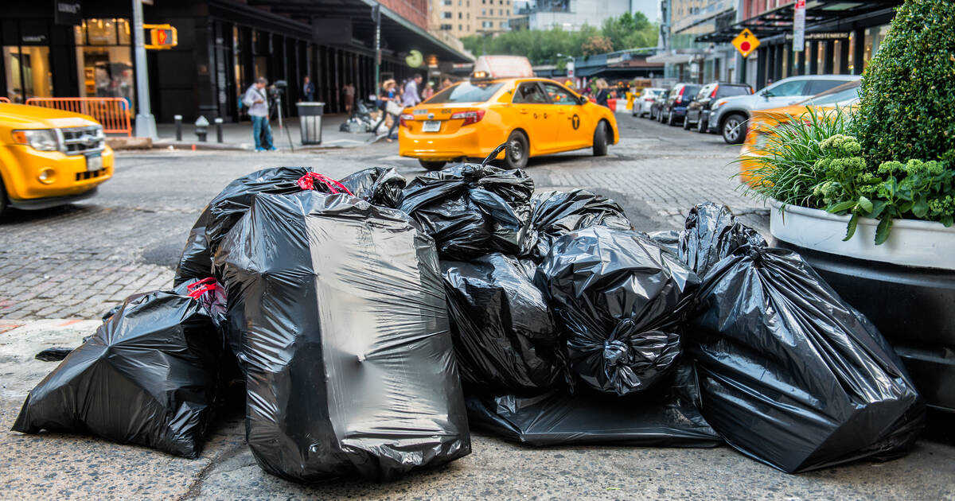
It's Now or Never.
Visit LocateYourWaste today to educate oneself & create personal impact.

Slide 12
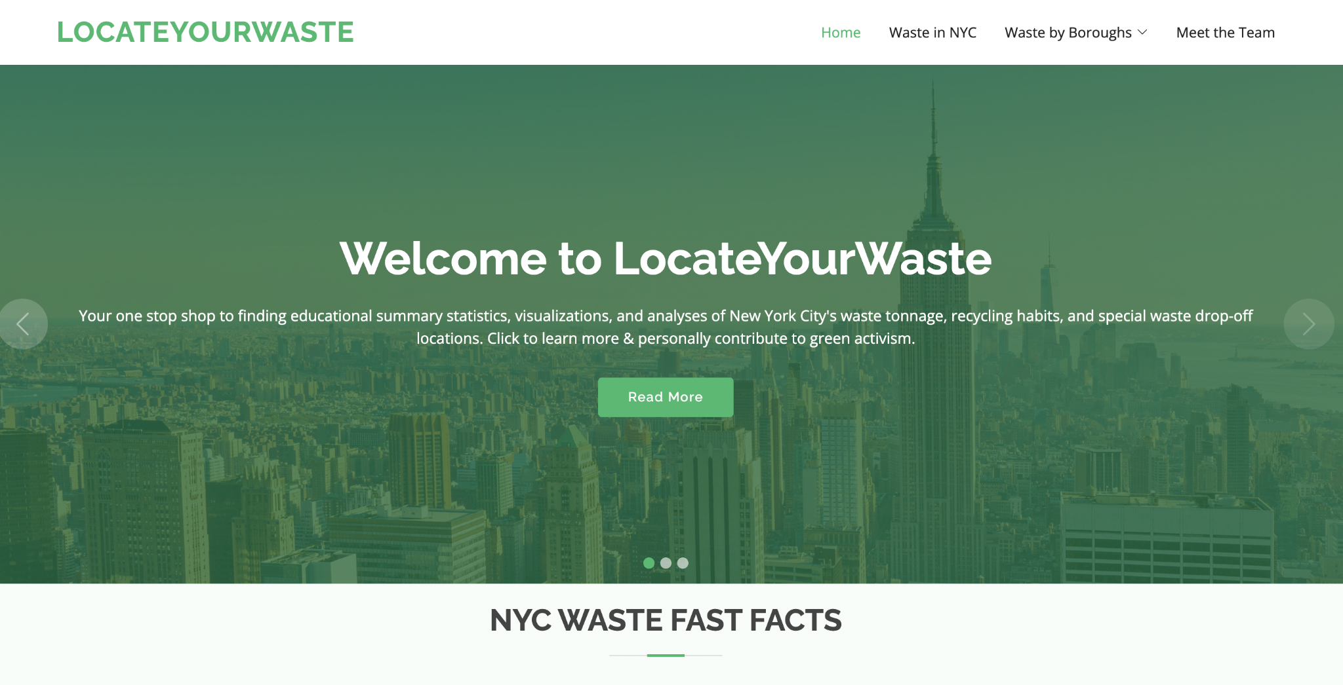
Thanks for listening!
now please hop on over to our website :)

Slide 13
Works Cited
Goldenberg, Sally, and Danielle Muoio Dunn. “New York City Fails Zero Waste Pledge. Why It's Going Backward.”
POLITICO, 22 Apr. 2022, https://www.politico.com/news/2022/04/22/zero-waste-new-yorkers-recycle-00026708.
Robbins, Christopher, et al. “Trash City: Here's Why New York Is so Filthy.” Streetsblog New York City, 28 Mar. 2022,
https://nyc.streetsblog.org/2022/03/22/trash-city-new-york-is-filthy-and-the-fault-is-government-inertia/.
“Top Line: Sending Zero Waste to Landfills by 2030.” NYC.gov,
https://www.nyc.gov/site/sustainability/codes/waste.page.

